Slide 1
λ-Calculus and Higher Order Functions
CMSC 330: Programming Languages

Slide 2
Introduction to λ-Calculus
What is λ-Calculus?
  A mathematical model of computation based entirely on functions, introduced by Alonzo Church in the 1930s
  Every computation is expressed by function definition and application
  Focuses on language semantics (what programs mean)
  Forms the theoretical foundation of functional programming languages like OCaml

Slide 3
Why λ-Calculus Matters?
λ-calculus is the theoretical foundation of functional languages
Helps understand first-class functions in OCaml
Explains higher-order functions, anonymous functions, and function application
Provides a formal model for language semantics — specifically, operational semantics can describe λ-calculus behavior
Notes:
Functions can be passed, returned, assigned, stored like any other value
So all functions in OCaml are first-class functions

Slide 4
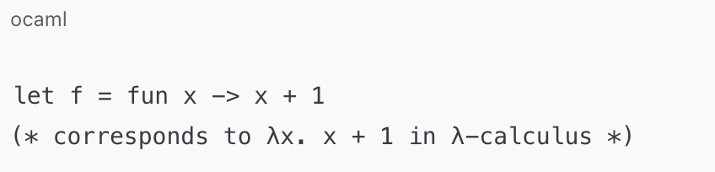
λ-Calculus: λ-Expressions
Variables
  Every variable is a λ-expression, e.g., x, y, z ∈ V
λ-Abstraction (Function Definition)
  If v ∈ V and E is a λ-expression, then λv.E is a λ-expression
  v is the function parameter, E is the function body

Slide 5
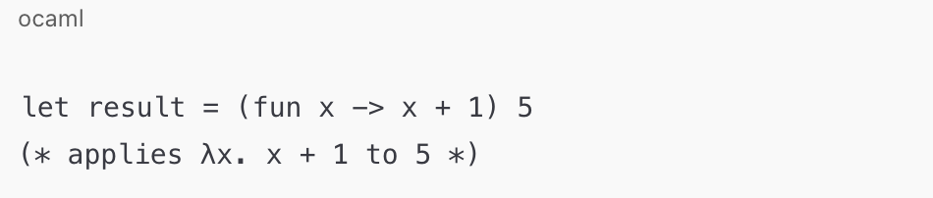
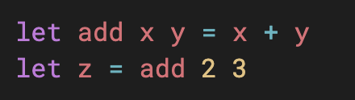
λ-Calculus: λ-Expressions
Function Application
  If E1 and E2 are λ-expressions, (E1 E2) is a λ-expression
  Represents applying function E1 to argument E2
  Chaining applications of nested functions implements currying. (What is the data type of the following function?)

Slide 6
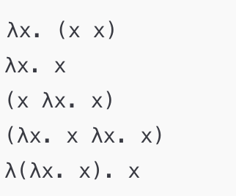
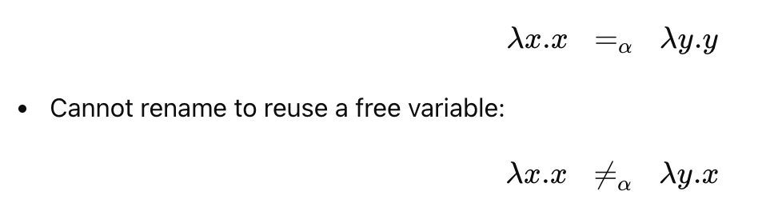
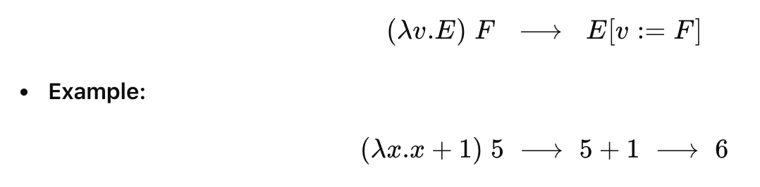
Pure (Untyped) λ-Calculus
λ-Expressions
  Are these λ-expressions?
α-Conversion (Renaming Bound Variables)
β-Reduction (Function Application)

Slide 7

λ-Calculus: Free and Bound Variables
In $λx.E$, $x$ is bound, all other variables in $E$ are free.
Let $FV\left(E\right)$ denote the set of free variables of a λ-expression $E$.
  FV(m n) = FV(m) U FV(n)
  FV(λx.E) = FV(E) – {x}
Try:
  FV(λx.x)
  FV(x λx.x)
  FV(λz.(λx.z))
Notes:
Empty,
{x} (why),
empty (why? {z} – {x} – {z})

Slide 8
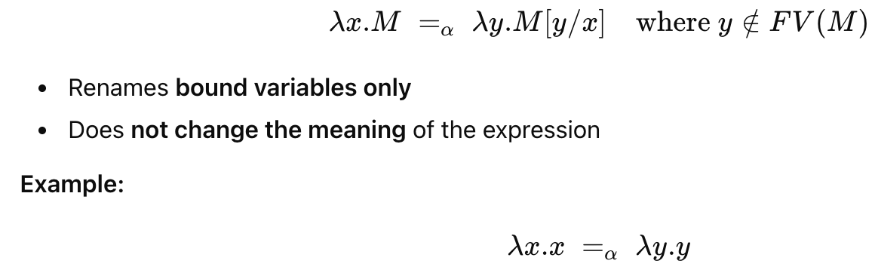
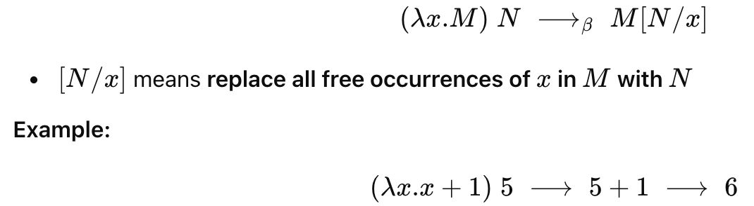
λ-Calculus: Formal Definition
α-Conversion (Renaming Bound Variables)
β-Reduction (Function Application)

Slide 9
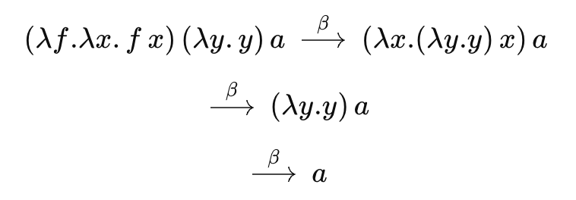
λ-Calculus: Examples

Slide 10

λ-Calculus: Examples
The following λ-expressions are called combinators:
  S = $λx.λy.λz. (x z (y z))$
  K = $λx.λy.x$
  I = $λy.y$
Key properties:
  They have no free variables
  They form the basis of combinatory logic
  Any λ-expression can be expressed using only S, K, and I

Slide 11

λ-Calculus: Examples
Try:
  K a b
  I a
  S a b c
Natural numbers can be represented using λ-expressions (Church numerals):
  0 = $λf.λx.x$
  1 = $λf.λx.(f x)$
  2 = $λf.λx.\left(f\left(fx\right)\right)$
  3 = $λf.λx.(f (f (f x)))$
Notes:
K ignores its second argument
I returns its argument unchanged
S distributes the argument $z$to both functions

Slide 12

λ-Calculus: Exercise
Addition is defined as:
  add = $λm.λn.λf.λx.((m f) (n f x))$
What is add 1 2?

Slide 13
Higher Order Functions
A higher-order function is a function that takes one or more functions as arguments or returns a function as a result.
Why Use HOFs?
  Expressiveness: Functions become first-class values, enabling elegant composition.
  Code reuse: Apply the same logic to different functions without rewriting recursion.
  Functional style: Core tool for pure FP, replacing loops and mutable state.

Slide 14
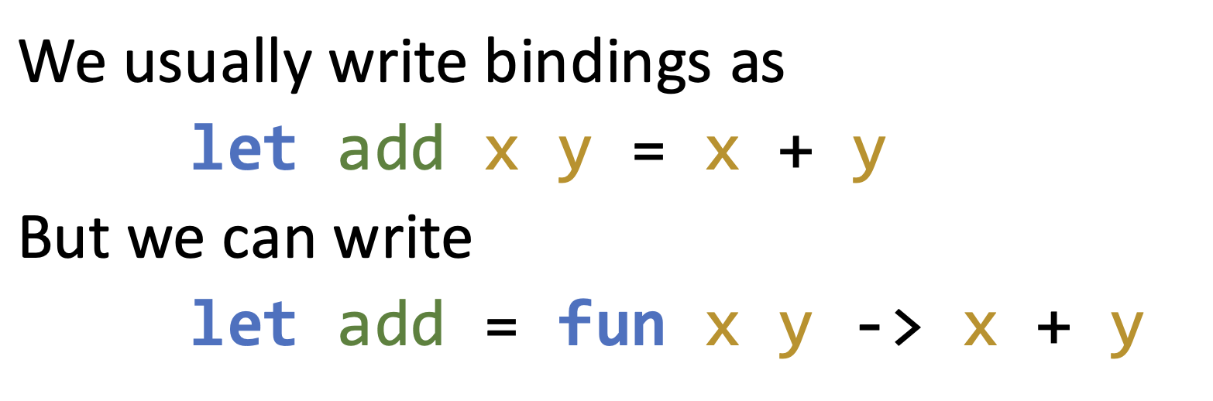
fun – Anonymous Function
fun is used to indicate that we have a function
  This function has no name
  This is called an anonymous (or lambda) function
Is add a HOF?
Notes:
In most pure functional languages (OCaml, Haskell, Scheme, etc.), all functions are conceptually lambdas.
The compiler treats let add x y = x + y as let add = fun x y -> x + y
add is a HOF, when it is partially applied, e.g., add 2 returns a function

Slide 15
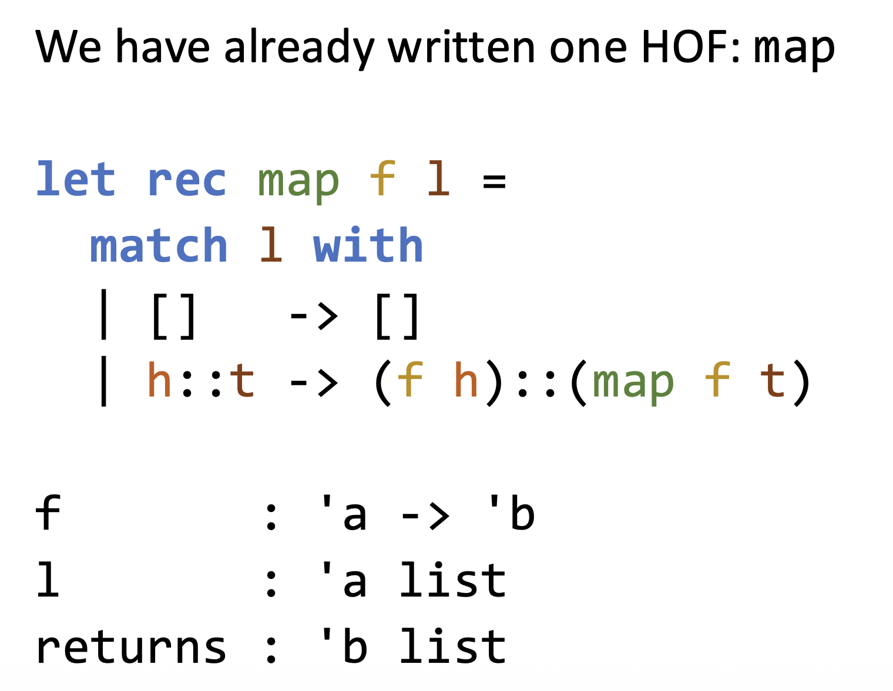
Example: map
Notes:
Return a new list by applying a given function f to each element of a list

Slide 16
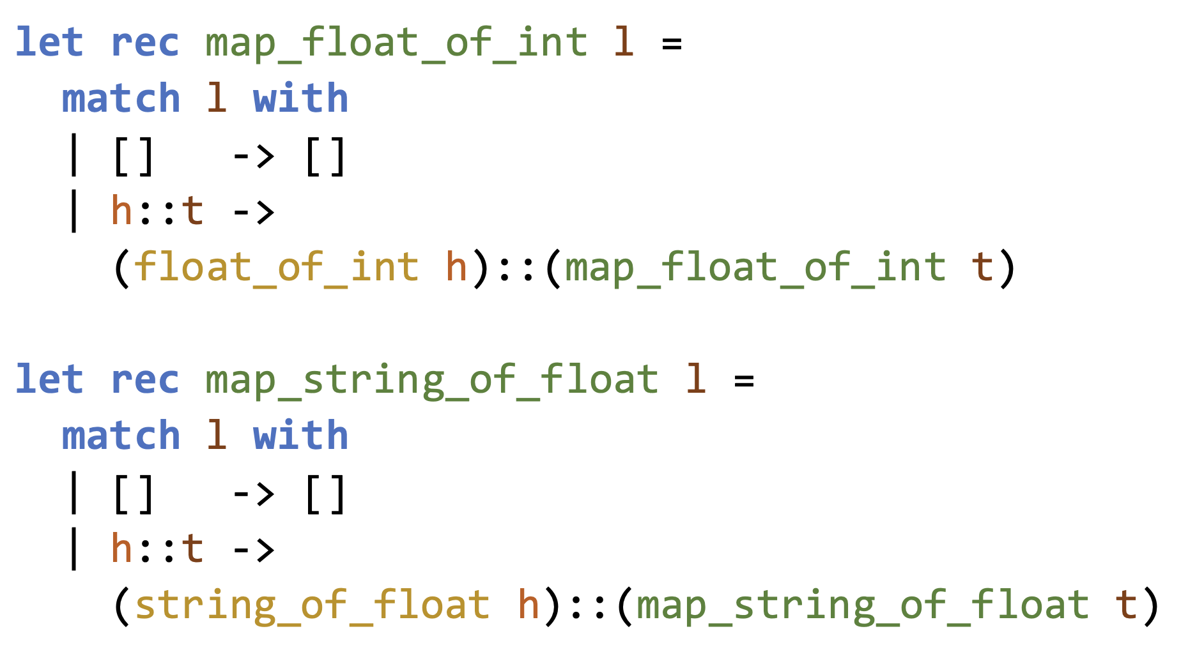
Without map
Notes:
float_of_int: int -> float

Slide 17
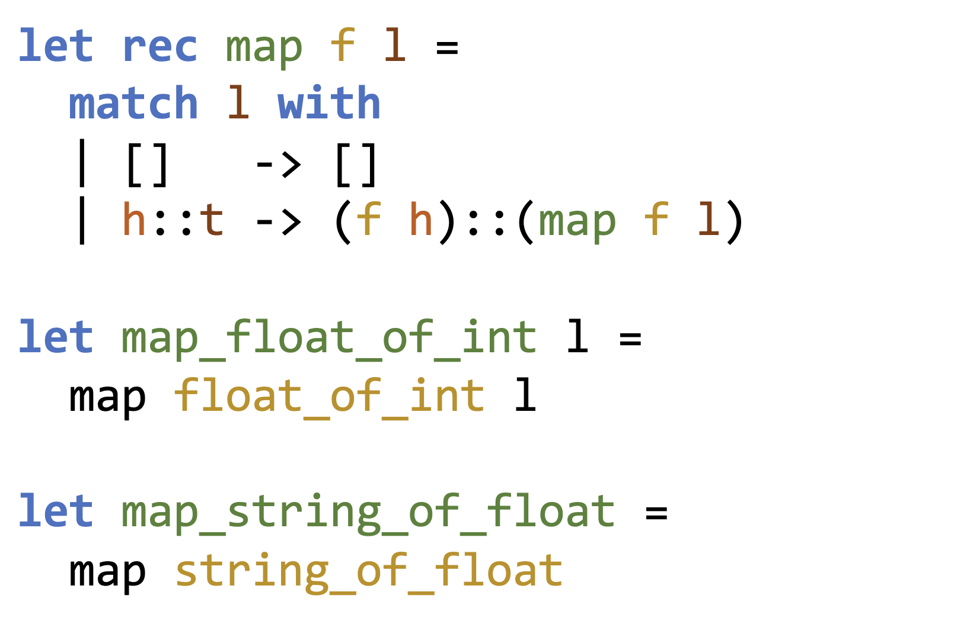
With map

Slide 18
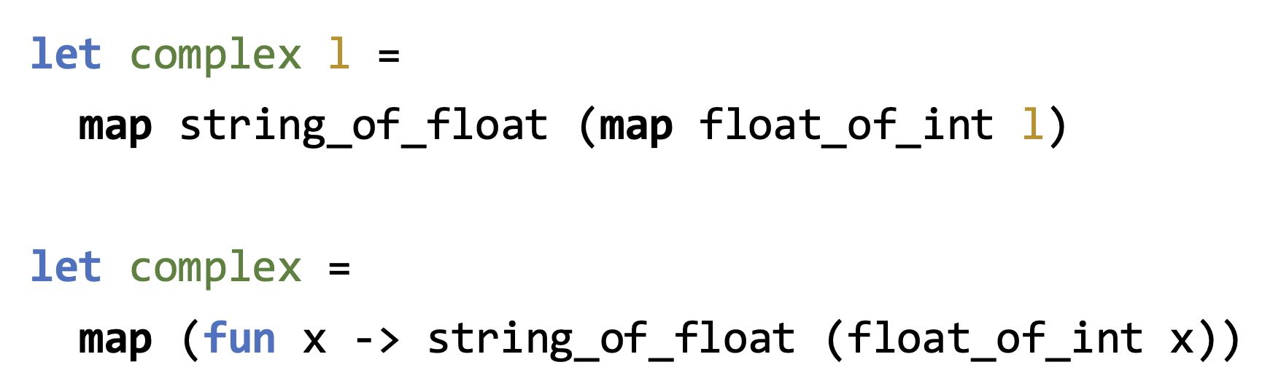
A More Complex Example
What are we doing here:
float_of_int: convert int to float
string_of_float: convert float to string
Notes:
Convert a list (data) from int to float, then convert float list to string list
HOFs can be used in multiple ways:
either chain multiple calls (stepwise): must call map twice
or pass a composed function (single traversal), call map once, with a function that takes a function as input

Slide 19
The Pipeline Operator |>
Super short definition:
  let ( |> ) a f = f a
Moves the “data” to the front, before the function — a data-first style
The left-hand value becomes the argument of the right-hand function
Evaluation flows naturally left-to-right
E.g., x |> f |> g is equivalent to g (f x)

Slide 20
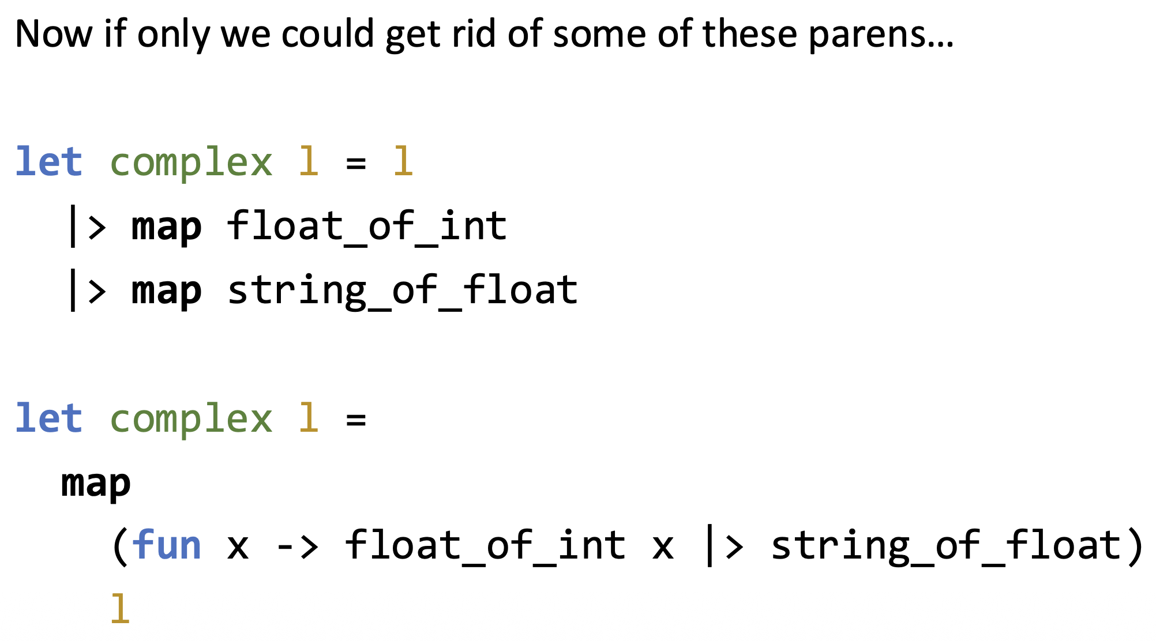
Revisit the Complex Example

Slide 21
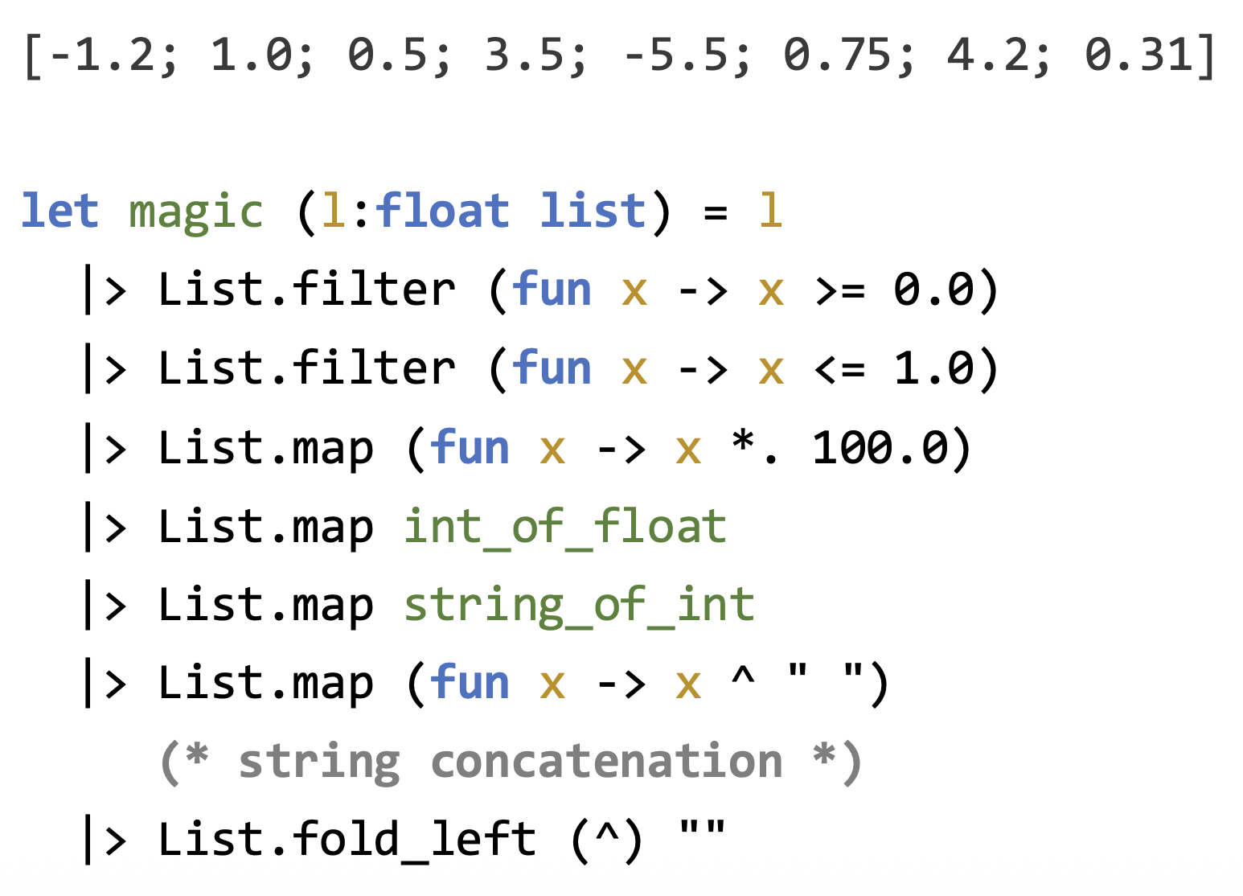
The Pipeline Operator in Use

Slide 22
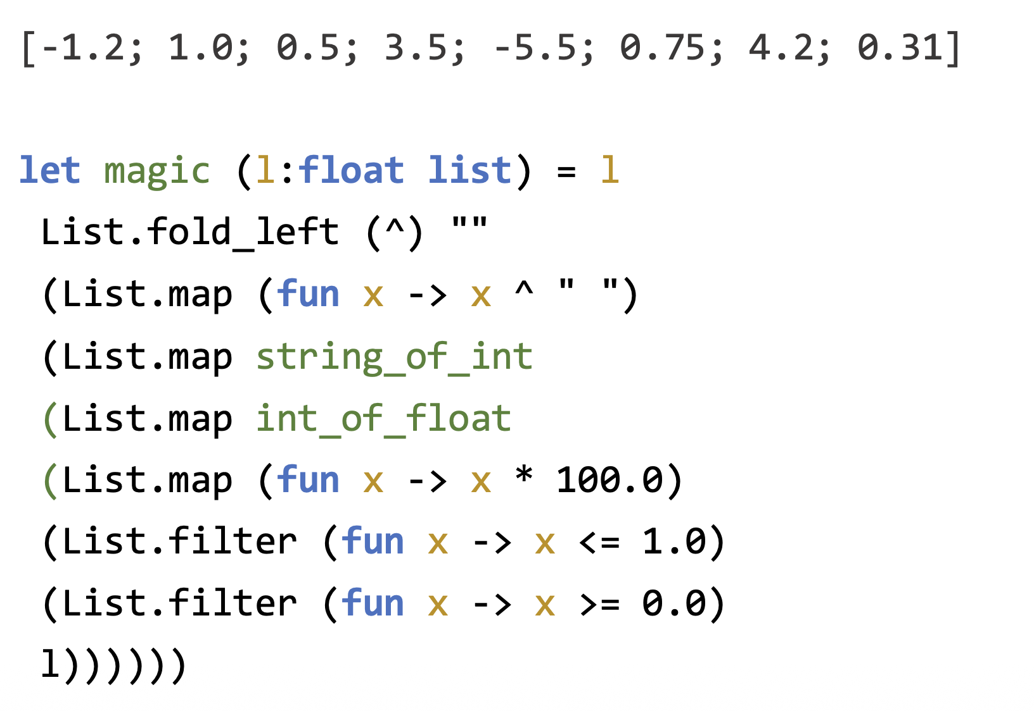
The Pipeline Operator NOT in Use

Slide 23
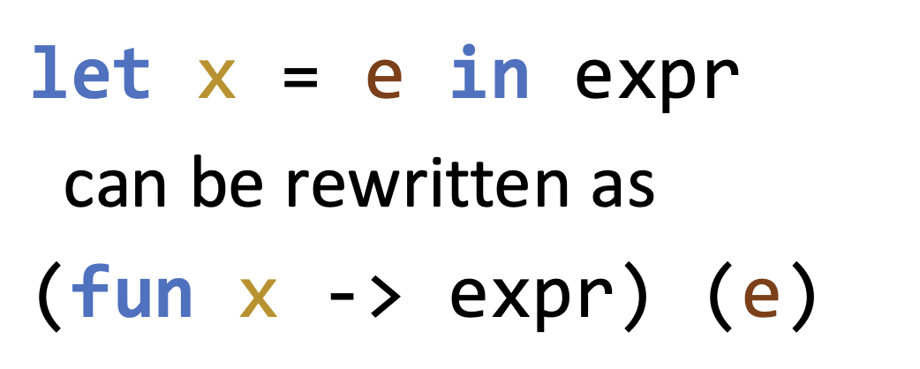
Revisiting Local Bindings
Local binding
This is exactly the function application in λ-calculus

Slide 24
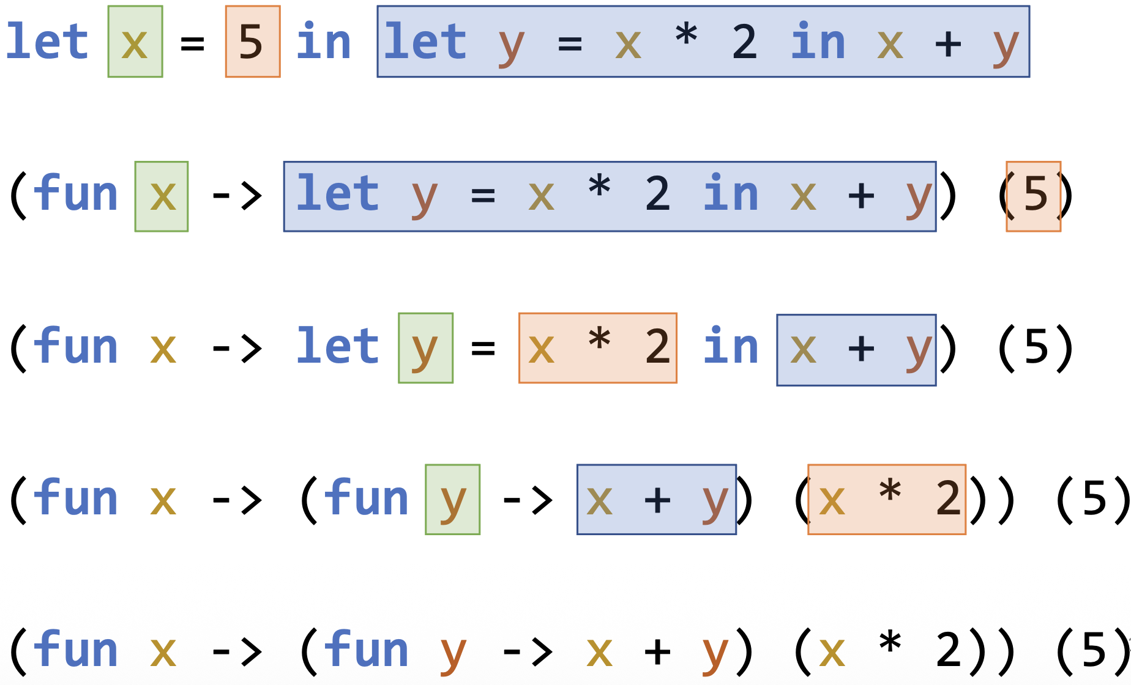
Local Binding Example
The corresponding λ-expression is
  (λx. (λy. x + y) (x * 2)) 5

